Slide 1
HTML FORMS & INPUT

Slide 2
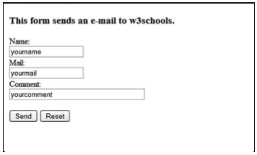
HTML forms
HTML forms are used to collect different kinds of user input. A form is an area that can contain form elements.
<form>
input elements .
</form>

Slide 3
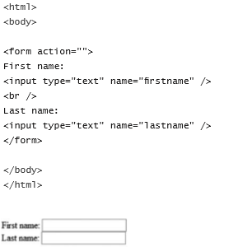
INPUT TAG AND ATTRIBUTES
TEXT FIELDS

Slide 4
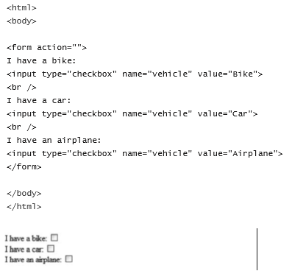
INPUT TAG AND ATTRIBUTES
Check Boxes

Slide 5
INPUT TAG AND ATTRIBUTES
RADIO BUTTONS
<form action="">
Male: <input type="radio" checked="checked" name=“Gender“ value="male">
<br>
Female: <input type="radio" name=“Gender" value="female">
</form>

Slide 6
INPUT TAG AND ATTRIBUTES
Drop-Down List
<form action="">
<select name="cars">
<option value="volvo">Volvo</option>
<option value="saab">Saab</option>
<option value="fiat">Fiat</option>
<option value="audi">Audi</option>
</select>
</form>

Slide 7
INPUT TAG AND ATTRIBUTES
text area
<textarea rows="10“ cols="30">The cat was playing in the garden.</textarea>

Slide 8
INPUT TAG AND ATTRIBUTES
Buttons
<form action="">
<input type="button" value="Hello world!">
</form>

Slide 9
INPUT TAG AND ATTRIBUTES
Fieldset
A fieldset is a grouping of data fields.
<fieldset>
<legend> Health information: </legend>
<form action="">
Height <input type="text“ size="3">
Weight <input type="text" size="3">
</form>
</fieldset>

Slide 10
INPUT TAG AND ATTRIBUTES
action attribute
When the user clicks the Submit button, the content of the form is sent to the server. The form’s action attribute defines the name of the file to send the content to.
<form name="input“ action="html_form_submit.php“ method="get">
Username: <input type="text“ name="user"/>
<input type="submit" value="Submit"/>
</form>

Slide 11
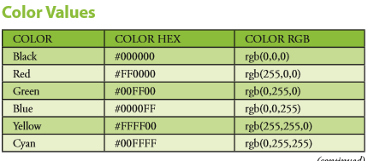
HTML COLOR

Slide 12
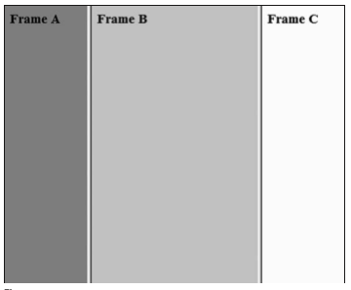
HTML FRAMES
Vertical Frameset
The following example demonstrates how to make a vertical frameset with three different documents.
<frameset cols="25%,50%,25%">
<frame src="frame_a.htm">
<frame src="frame_b.htm">
<frame src="frame_c.htm">
</frameset>

Slide 13
HTML FRAMES
Horizontal Frameset
The following example demonstrates how to make a vertical frameset with three different documents.
<frameset rows="25%,50%,25%">
<frame src="frame_a.htm">
<frame src="frame_b.htm">
<frame src="frame_c.htm">
</frameset>

Slide 14
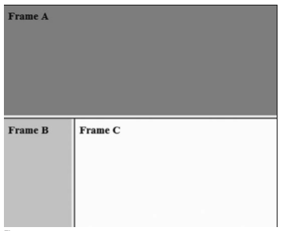
HTML FRAMES
<html>
<frameset rows="50%,50%">
<frame src="frame_a.htm">
<frameset cols="25%,75%"> <frame src="frame_b.htm"> <frame src="frame_c.htm"> </frameset>
</frameset>
</html>

